Slide 1
Reflexive & Intensive Pronouns
How Do I Know The Difference?

Slide 2
Reflexive Pronouns
Reflexive sounds like reflection, the image in the mirror that bounces back at you.
A reflexive pronoun reflects back to the subject.
A reflexive pronoun can be used as the direct object, indirect object, or object of a preposition in a sentence.

Slide 3
Intensive Pronouns
Intensive is like intense.
Something intense is very strong.
An intensive pronoun emphasizes a preceding noun, often the noun immediately before the pronoun. It is not necessary to the sentence.

Slide 4
These pronouns are reflexive or intensive depending on their use in a sentence.
Singular | Plural
myself | ourselves
yourself | yourselves
himself herself itself | themselves

Slide 5
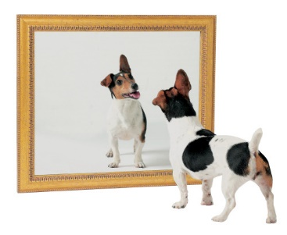
Reflexive Example
Reflexive: The puppy saw itself in the mirror.
Itself is the direct object in the sentence. The pronoun refers back to the subject. The puppy saw the puppy in the mirror.

Slide 6
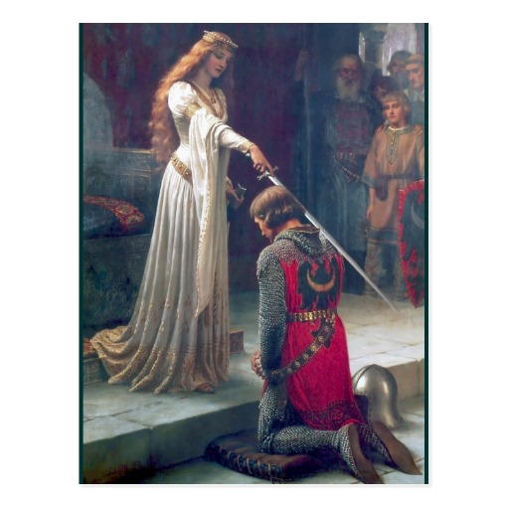
Intensive Example
Intensive: The queen herself gave the knight the award. The queen gave the knight the award herself.
Herself refers to the queen.
Hint: You can leave it out of the sentence!

Slide 7
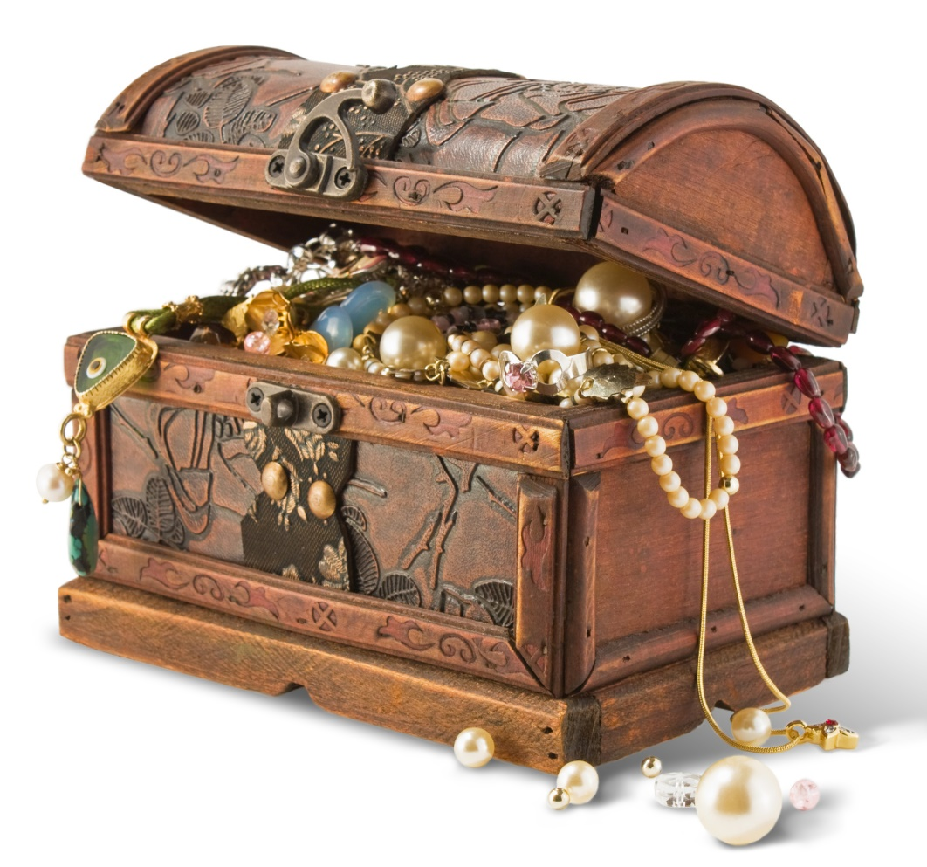
Reflexive or Intensive?
I found the treasure box myself.
Intensive

Slide 8
Reflexive or Intensive?
You yourself should know the rules for pronoun usage.
Intensive

Slide 9
Reflexive or Intensive?
When Jeremy found his wallet, he bought himself an ice cream.
Reflexive

Slide 10
Reflexive or Intensive?
The Mayor himself gave me this award.
Intensive

Slide 11
Reflexive or Intensive?
My sister bought herself a birthday present.
Reflexive

Slide 12
Reflexive or Intensive?
My neighbors found themselves involved in a lawsuit.
Reflexive

Slide 13
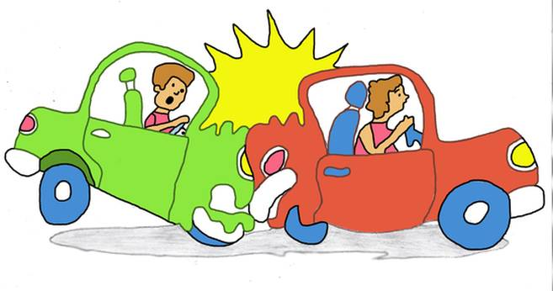
Reflexive or Intensive?
The police officer herself witnessed the accident.
Intensive

Slide 14
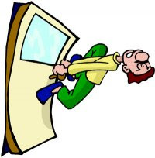
Reflexive or Intensive?
Four students found themselves locked out of the room when they were late to class.
Reflexive

Slide 15
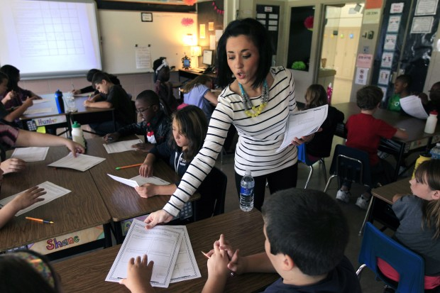
Reflexive or Intensive?
I gave you that worksheet myself so I know you have it.
Intensive

Slide 16
Reflexive or Intensive?
The television announcer could not hear himself speaking, so he spoke louder and louder.
Reflexive

Slide 17
Reflexive Pronouns
Remember! – If you can take the pronoun out of the sentence and it does not change the meaning of the sentence, it is INTENSIVE.
If the pronoun must stay in the sentence, it is REFLEXIVE.

