Slide 1
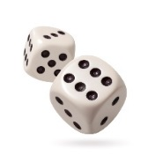
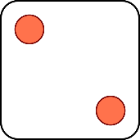
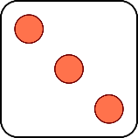
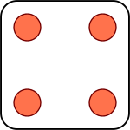
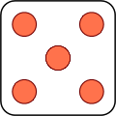
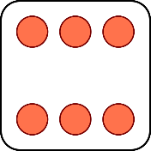
Vocabulary
Rock & Roll
Complete at least 4 of the 6 options.
Arrange these by task, not by word. Complete each task for all words on your vocabulary list. Additional options may be completed for extra credit. Extra credit options are worth five (5) points for each task.
Define
the
Word.
Draw
It!
List
at least 3
Synonyms.
What does
it remind
you of?
Use the
word in
a sentence.
List
at least 3
Antonyms.
Vocabulary
Rock & Roll
Complete at least 4 of the 6 options.
Arrange these by task, not by word. Complete each task for all words on your vocabulary list. Additional options may be completed for extra credit. Extra credit options are worth five (5) points for each task.
Define
the
Word.
Draw
It!
List
at least 3
Synonyms.
What does
it remind
you of?
Use the
word in
a sentence.
List
at least 3
Antonyms.

Slide 2
Stem Words
Add new words to this chart that use the stem from your vocabulary list . Make sure to use the correct meaning and give the definition of the word you selected.
STEM | MEANING | NEW WORD | DEFINITION
Stem Words
Add new words to this chart that use the stem from your vocabulary list . Make sure to use the correct meaning and give the definition of the word you selected.
STEM | MEANING | NEW WORD | DEFINITION

