Slide 1
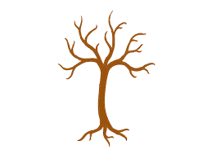
Vocabulary Trees
Complete the tree by adding your vocabulary word to the trunk, definitions to the roots, and fill the branches with at least 8 related words, information and examples.

Slide 2
Stem Words
Add new words to this chart that use the stem from your vocabulary list . Make sure to use the correct meaning and give the definition of the word you selected.
STEM | MEANING | NEW WORD | DEFINITION

Slide 3
Vocabulary Trees
Complete the tree by adding your vocabulary word to the trunk, definitions to the roots, and fill the branches with at least 8 related words, information and examples.

Slide 4
Stem Words
Add new words to this chart that use the stem from your vocabulary list . Make sure to use the correct meaning and give the definition of the word you selected.
STEM | MEANING | NEW WORD | DEFINITION

